Slide 1

Final Report
Management of Information Systems
Group: 05

Slide 2



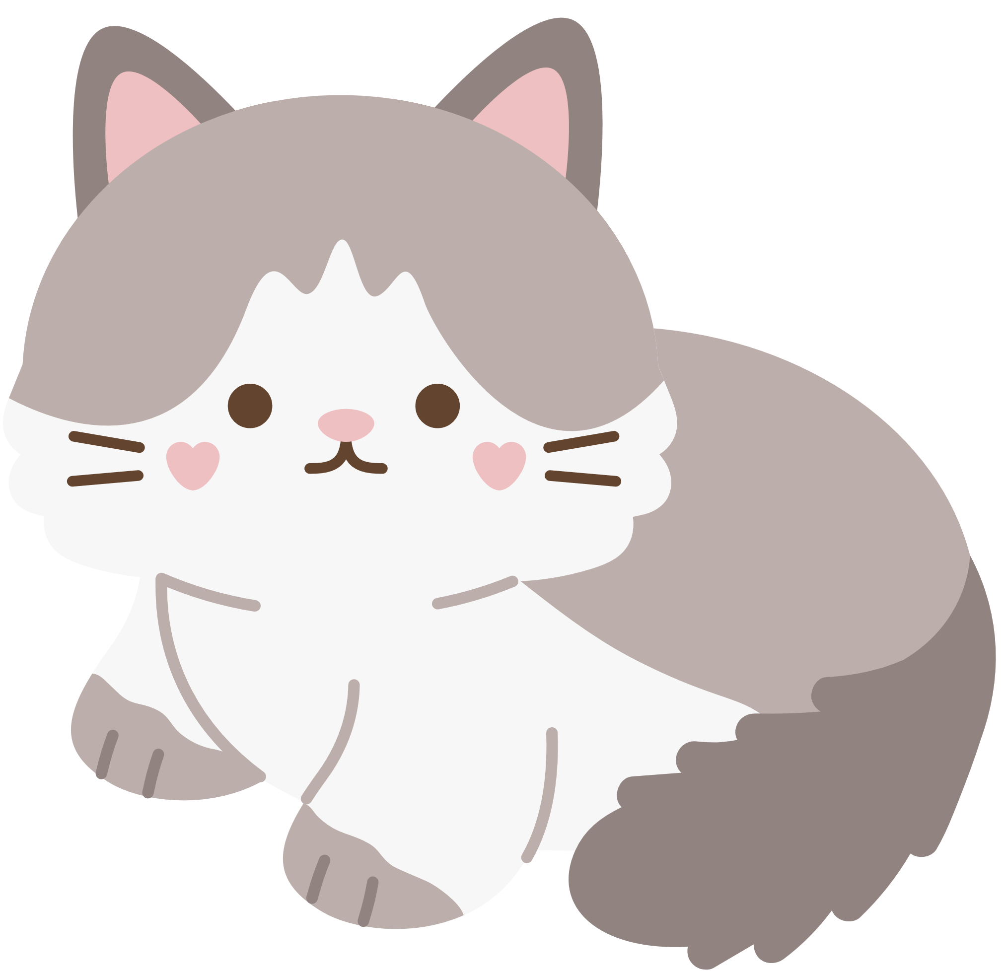
Describe your business. Strategy. Information structure. Existing problems. Source code. Presentation. | 100%
Usecase Diagram ,ERD. Improvements. Analyze the improvements. Source code. | 100%
Industry structure. Value chain. Inducement. Identify ethical and privacy issues. Evaluation, conclusion. Source code. | 100%
Phạm Trần Tiến Phát
521H0285
Lê Minh Anh
521H00004
Phan Thành Đạt
521H0218

Slide 3

Introduction
“Prestige Imperial” is a hotel located in the heart of Ho Chi Minh City, providing a classy living space with modern architecture and sophisticated design for customers to enjoy a luxurious lifestyle.

Slide 4





Objectives
Luxury brand.
Unique creativity.
Leading the tourism industry.

Slide 5



Mission
.
Enhance customer experiences.
Design a modern living space.
Smart environment.

Slide 6
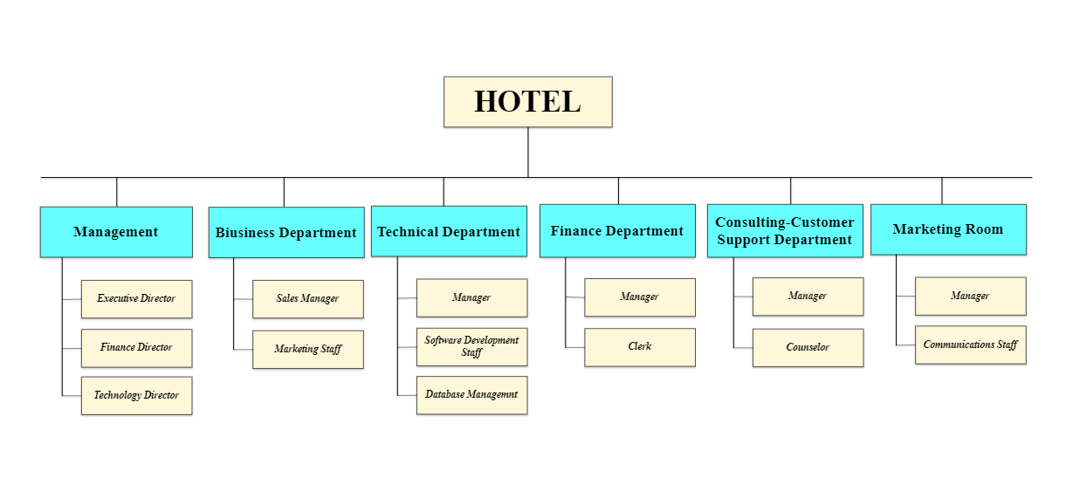
Organization chart

Slide 7
INDUSTRY STRUCTURE

Slide 8

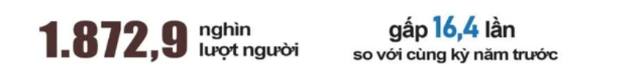
COVID
-19
2022
March 15, 2022 Reopening for tourism.
Quarter 3 / 2022
In March 2020, the number of tourists decreased sharply to only nearly 450,000 visitors.
A decrease of 68.1% compared to the same period in 2019.
Tourism revenue is 7,800 billion VND.
Tourism revenue in 2022 reaches 120,000 billion VND.
Increased 171% but 14% lower than 2019.

Slide 9
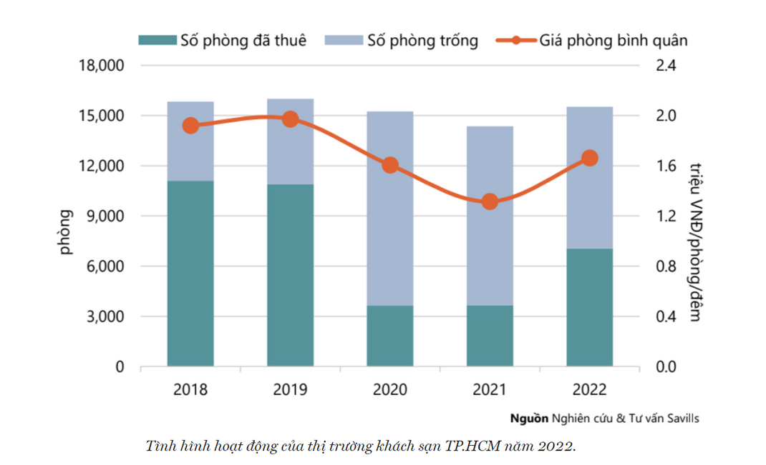
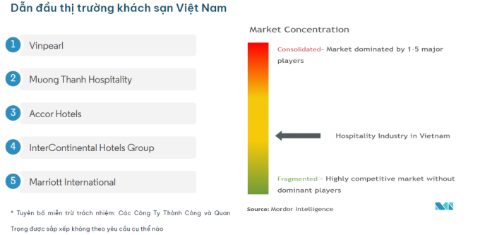
The hotel industry in Vietnam has grown continuously based on increased tourism.
Influenced by both international and domestic visitors.
The majority of hotels in Vietnam are independent or domestic.
By the end of 2022, in Ho Chi Minh City, hotel supply will reach more than 15,500 rooms from 111 projects.
Increased 8% year-on-year.

Slide 10
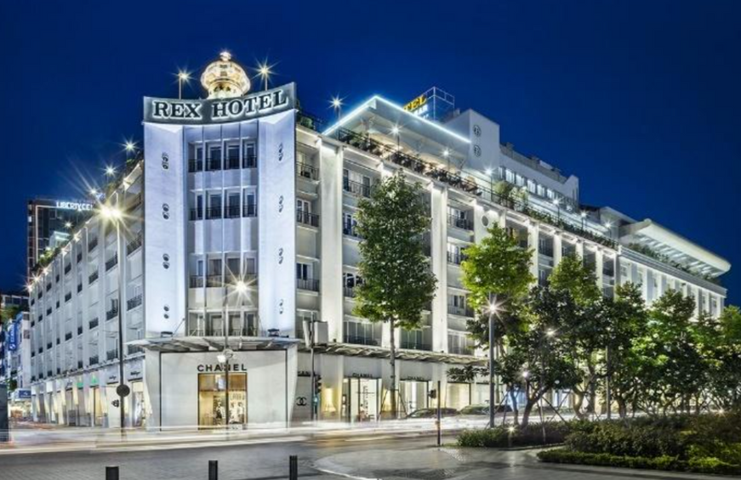
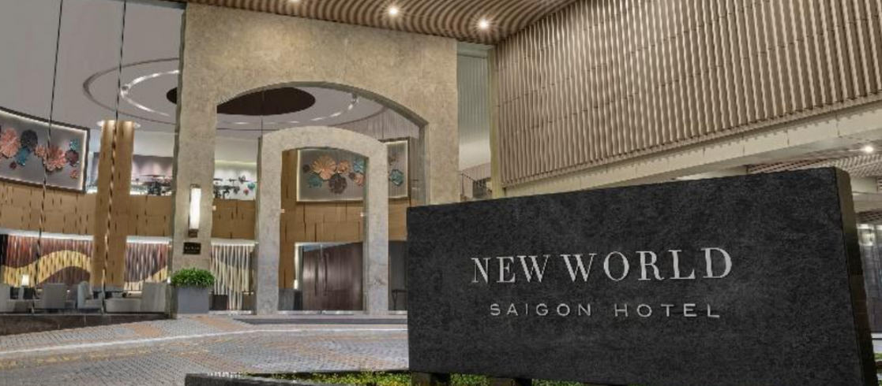
Competitive forces
Traditional competitor
Rex Hotel Saigon:
A prestigious 5-star hotel.
Operating for more than 90 years.
Located in the center of District 1.
New World Saigon:
A pioneer 5-star hotel in a prime location.
History of more than 25 years.

Slide 11
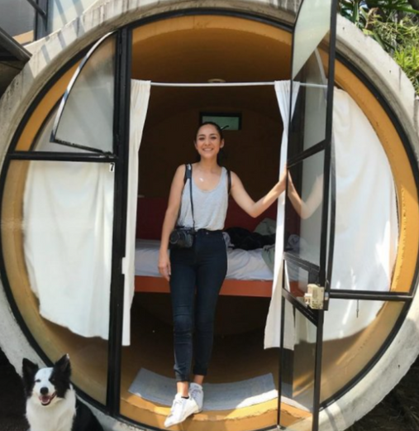
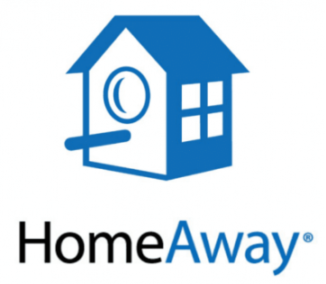

Competitive forces
New market entrants
Online Travel Agencies - OTAs:
Finding deals
Compare prices.
Read reviews.
Intensifying competition.
Alternative Accommodation Platforms:
Cheaper
Offer unique lodging experiences
Challenge for traditional hotels.
Bontique and small hotels:
Providing unique services and experiences

Slide 12



Competitive forces
Power of suppliers.
Negotiating terms with hotels
Determining prices, discounts, and marketing strategies.
-> Effective product promotion for mutual benefit.
Navigate competition
Avoid losing customers or losing revenue due to unsuccessful negotiations.
Bargaining power
-> protect benefits thereby improving business efficiency.

Slide 13
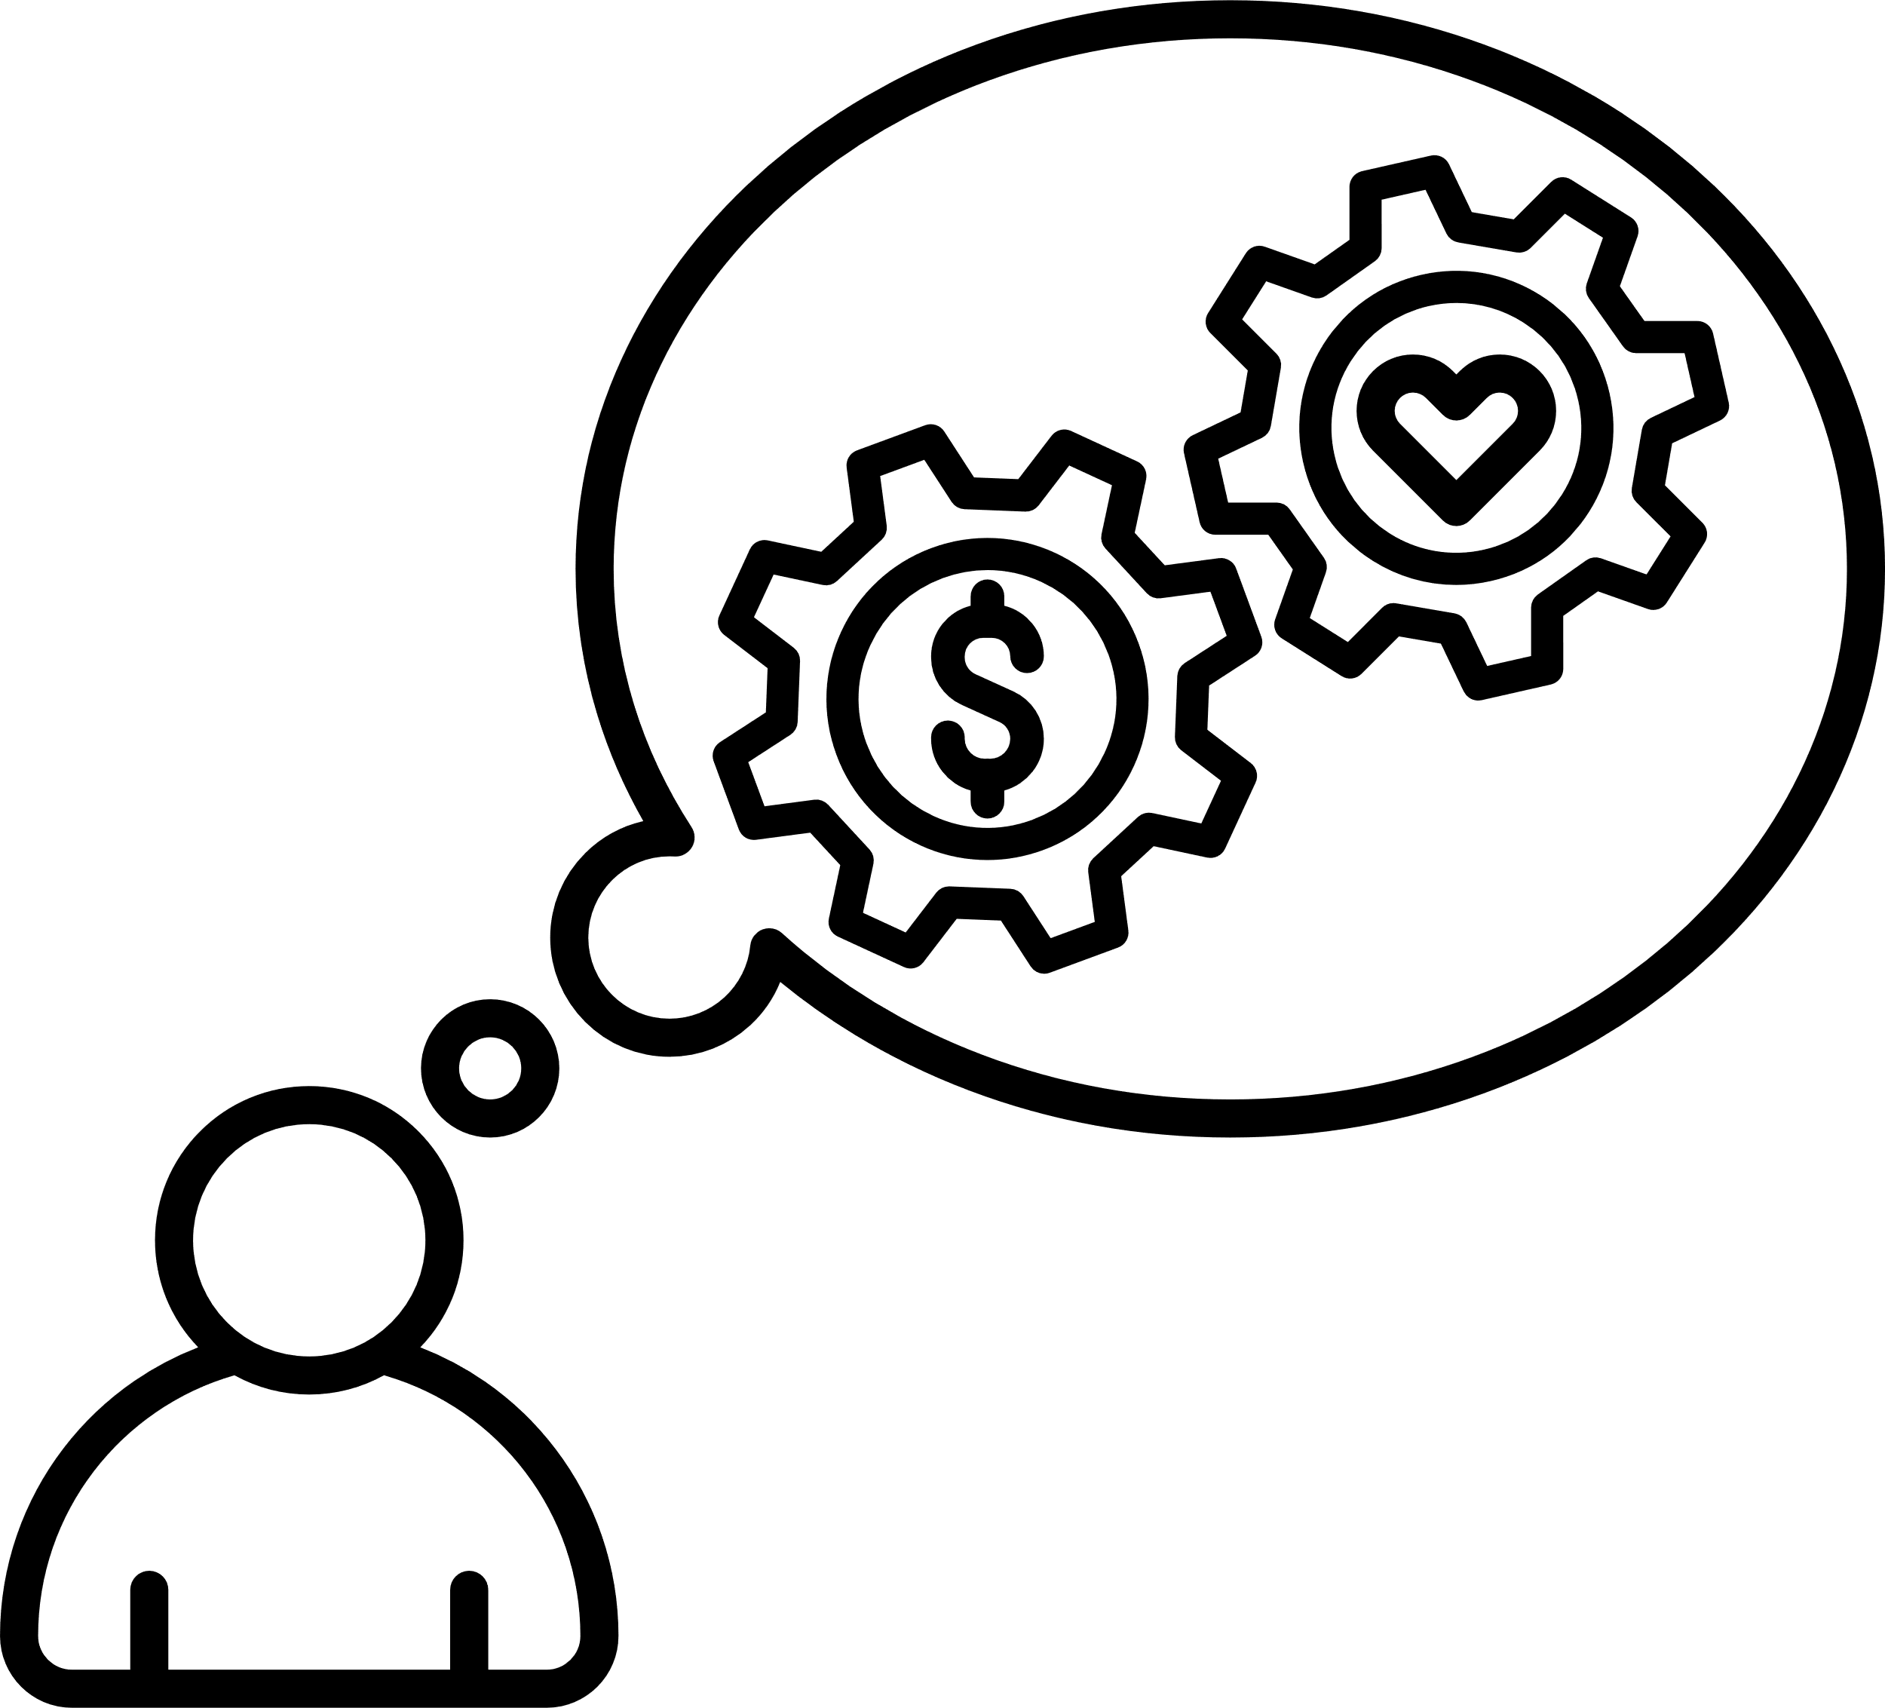

Competitive forces
Power of customers
Negotiate terms to enhance their experience and benefits.
Negotiate for discounts
Wi-Fi free and 24/7 room service

Slide 14
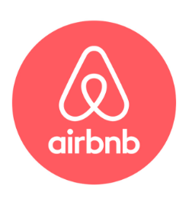
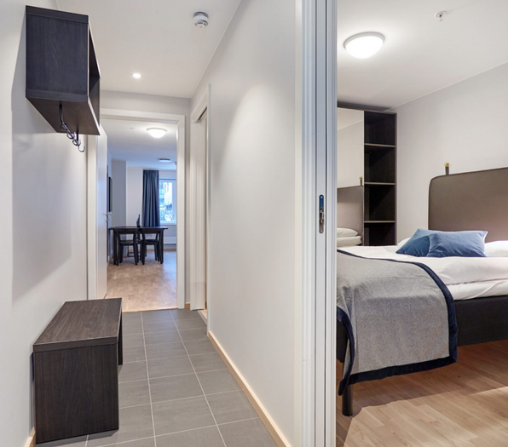
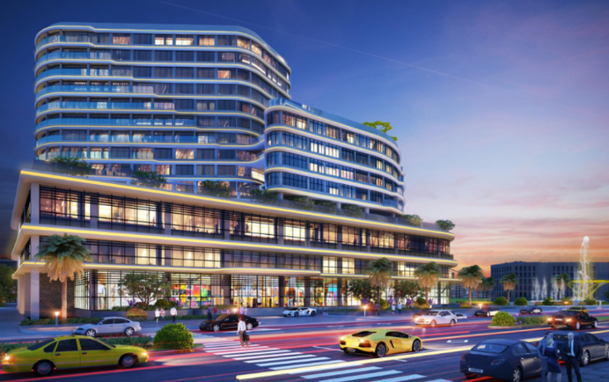
Competitive forces
Threat of substitues.
Serviced Apartments:
Free and flexible accommodation
Competition with traditional hotels
Resort-Style Commercial Spaces:
All-in-one experiences.
Use local landscapes, activities attracts customers
Home Sharing and Room Sharing:
Lower prices.
Closer experience of local life.
Personal experiences and private spaces.

Slide 15
Competitive advantage
The location (district 1) makes customers' travel more convenient.
A smart room placement system avoid unoptimized room availability.
Only needs service staff ensure customers get the best service.
Supports many different forms of payment but requires to reserve at least 50% of the service value in advance.

Slide 16
Competitive Strategy
Stage 1
(2024-2025)
Stage 3
(2029-2031)
Stage 2
(2026-2028)
Stage 4
(2032-2034)
Focus on Strategy
Product Differentiation Strategy.
Product Differentiation Strategy.
Product Differentiation Strategy.

Slide 17


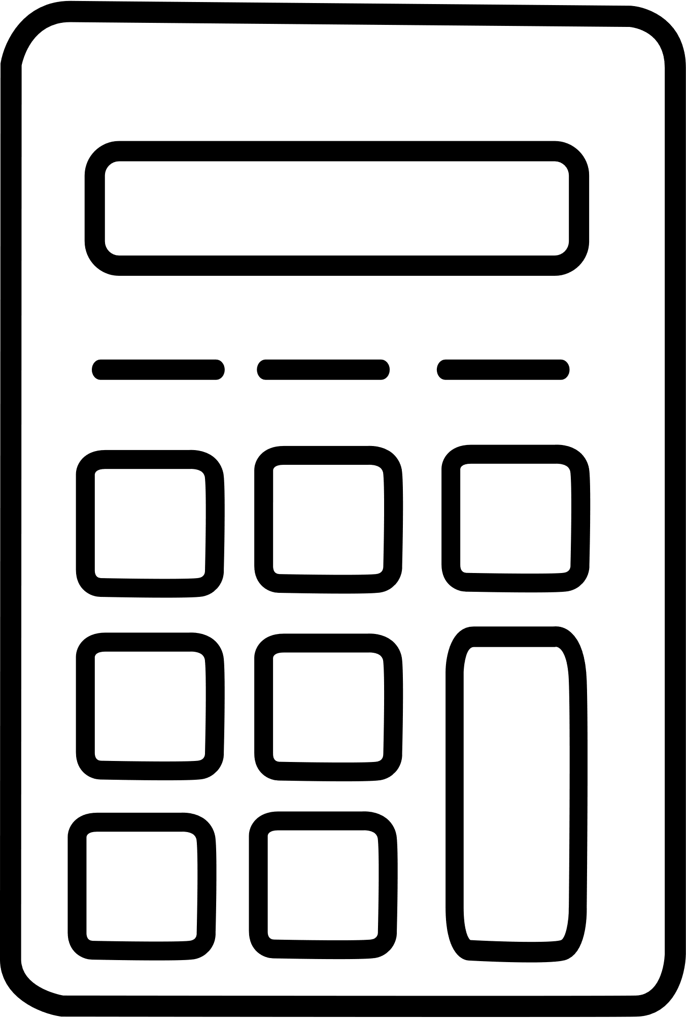
Stage 1 (2024-2025): Focus on Strategy
Upgrade and develop large facilities
Convenient for opening branches in the future
Design and test-run a few rooms
Track and calculate
Apply the model of highly booked rooms to low booked rooms

Slide 18


Stage 2 (2026-2028): Product Differentiation Strategy.
Improving customer experience
Applying artificial intelligence and data to provide personalized experiences.
Integrating IOT to automate utilities in the room slowly adjusts the light and temperature from the air conditioner.
Bringing virtual reality tours for customers to explore.

Slide 19


Stage 3 (2029-2031): Product Differentiation Strategy.
Improving the system to avoid falling behind the general level.
Signing with businesses, tourism parties to get a solid number of customers.

Slide 20


Stage 4 (2032-2034): Product Differentiation Strategy.
Open more branches and expand in neighboring areas.
Changing the decoration in the room.

Slide 21





VALUE CHAIN
Main activities
Inbound logistics
Order furniture
Sign long-term contracts to produce requested items
Operation
Manage and regularly check equipment and rooms
Monitor market trends
Outbound Logistics
Distribution activities
Providing products and services to consumers.
Marketing and Sales
Create marketing and advertising campaigns,
Collect customer feedback, and analyze data.
Customer Service
Collect opinions and reviews from customers
Handle customer problems during service use.

Slide 22



VALUE CHAIN
Support activities
Procurement
Contact places that provide goods to ensure licenses, issue invoices, and ensure safety in quality and hygiene.
Technology development
Actively apply technologies such as smart room control and effective resource management with asset tracking features.
Human resource management
Develop criteria for employee selection, team building and training.
Firm infrastructure
Ensure rooms are always well maintained and equipment is always maintained and upgraded.

Slide 23
INFORMATION SYSTEM
Hardware
Computers are used to run related programs such as data storage, monitoring, cleaning, and servicing
Applications and websites for customers and employees. Invest in developing software used to control robot operations and camera monitoring software
Software
Human
Includes customers who are system users, technical experts who build the system, marketing experts, and lawyers.
Customers enter information and the system checks age, allows guests to choose rooms, records length of stay and requested services. After checking out, the robot checks the room and cleans it.
Procedure
Customer transaction data and can be used to analyze customer behavior, personalize service offerings, and improve the customer experience.
Data

Slide 24




ORGANIZATION ISSUES
01
03
Low-quality fire alarm system.
Energy wastage.
02
Website not yet developed.

Slide 25
Low-Quality
Fire Alarm System

Slide 26
Existing
Problem
IoT systems integrate sensors and devices.
Enabling real-time monitoring and emergency response.
Improving service quality and optimizing hotel operations.
Outdated fire alarm systems cause reduced performance and reliability concerns.
Encountered many system errors and unhappy customers.
Lack of real-time data and remote monitoring capabilities has made it difficult to identify and resolve potential problems.
Expectation

Slide 27
Software
Not integrated with other hotel systems
=> difficult to respond effectively to emergencies.
Not provide real-time data analysis.
=>difficult to be proactive to prevent fires.
Hardware
Outdated analog equipment.
=> prone to problems and failures and causing the risk of false alarms.
The network system is insufficient to support the fire alarm system.
=> leading to connection problems and system downtime.
Process
not regularly maintained
->system failure and reduced efficiency.
Employees lack knowledge about how to use
-> Leading to confusion and errors
Data
not provide real-time data,
-> makes it difficult to respond quickly.

Slide 28
Website not yet deployed

Slide 29


Expectation
Create a website for the hotel to provide information and
services.
Create a smart room control system based on
IoT technology.
IoT technology can also be applied to
monitoring and system management of
devices.
Without website, it will reduce access to reach customer.
Direct booking puts customers at a disadvantage in finding the room they want.
Existing Problem

Slide 30


INDUCEMENT
Hardware and Software:
Old hardware and software systems
=> cannot meet modern website management.
Lack of knowledge or resources
=> unable to deploy new technologies for the hotel system.
Data:
There is not enough data needed => cannot build an effective website
Data is not either updated regularly or synchronized between internal
=> making it difficult to present on the website.
Process:
Lack of long-term strategy in applying technology to promote and develop online business

Slide 31
Energy Wastage

Slide 32
Expectation.
IoE applications help hotel systems optimize energy management.
Monitoring and analyzing energy consumption will help hotels build a better image.
Existing
Problem.
Lack of ability to monitor and manage electricity
consumption causes wasteful energy consumption.
Electrical systems are used without a clear plan leading to negative impacts.
Outdated equipment and technology lead to inefficient operations and incidents.

Slide 33

Data:
The hotel lacks a system to monitor and track real-time energy usage data.
The lack of energy data analysis hinders identifying trends, patterns in energy use and preventing waste.
Hardware:
The hotel's energy system is based on outdated equipment and technology, operates inefficiently, and is prone to incidents.
Inadequate hotel energy storage capacity leads to frequent energy waste and high electricity bills.
INDUCEMENT
Human
Hotel staff have not been trained on efficient energy use methods -> ineffective energy use causes waste.
Employees and departments do not communicate, leading to a lack of coordination in energy saving.

Slide 34
Process:
The hotel's electrical system is not properly maintained, leading to equipment damage and energy waste.
Guest energy usage patterns are not optimized, leading to energy waste and high energy bills.
INDUCEMENT
Software:
The hotel's energy system is based
on outdated equipment and technology, operates inefficiently, and is prone to incidents.

Slide 35
PROPSAL OF
A NEW SYSTEM

Slide 36

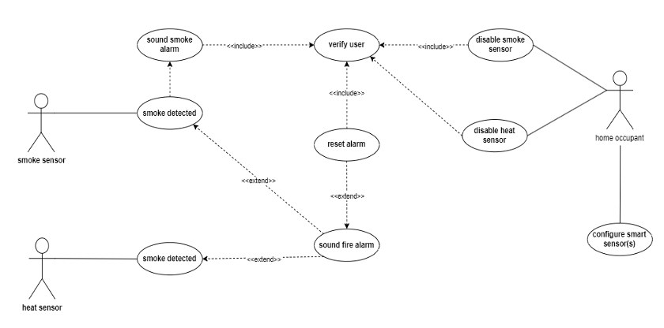
USE CASE DIAGRAMS: FIRE ALARM SYSTEM

Slide 37
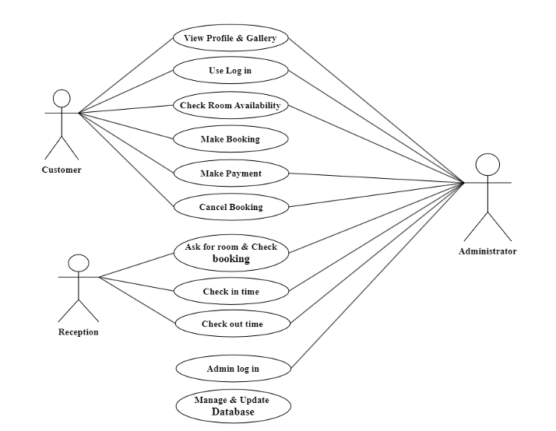
USE CASE DIAGRAMS HOTEL WEBSITE

Slide 38
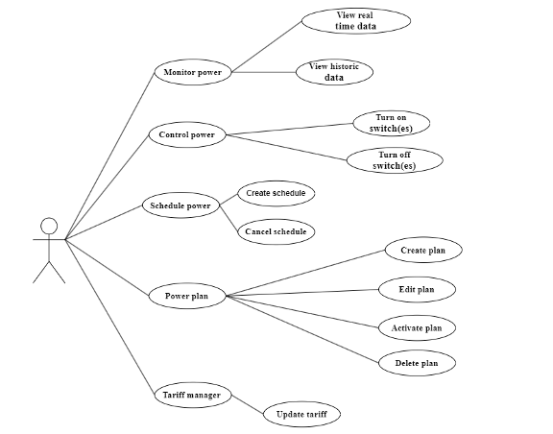
USECASE DIAGRAM ENERGY SYSTEM

Slide 39
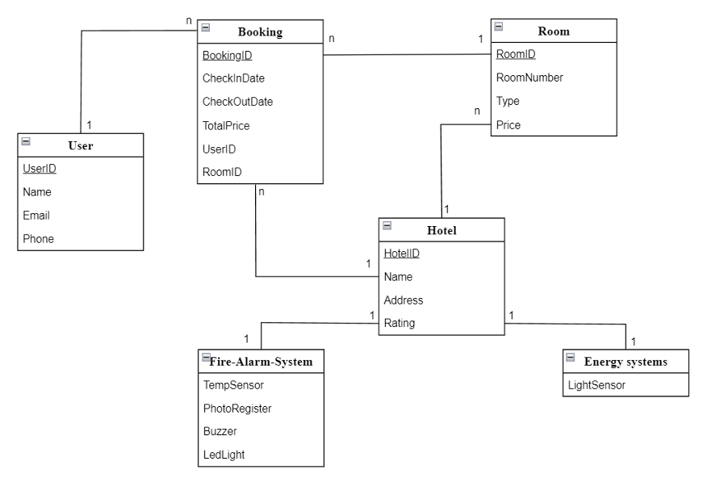
ERD

Slide 40



IMPROVE TECHNIQUES
Fire alarm system
Hotel website
Energy System
Integrating fire alarm systems with IoT allows for remote monitoring, centralized management, and improved data access to ensure building safety, allowing for better decision-making and proactive response fire deputy.
IoT can be used to develop websites that connect to smart devices, automating data collection to improve customer service and marketing.
IoT technology can help save energy by monitoring and adjusting consumption, optimizing device operation, and enabling automatic recovery grids in case of power leakage.

Slide 41




Identify ethical and privacy issues
Ensures protection of personal information and user consent
Be transparent about security and privacy policies
Ensure data safety and security
Update and accurate data to ensure efficient operations

Slide 42

EVALUATION AND CONCLUSION
Pros
Cons

Slide 43
Investment is needed for equipment, installation, and staff training.
Security poses a major challenge
Risking operational disruptions , affecting the customer experience and hotel operations.
Pros:
Automation of operations like lighting:
Temperature control.
Room service.
Efficient data management.
Energy savings.
Personalized guest services.
Enhanced security with sensors.
Surveillance cameras.
Cons:

Slide 44
Significant Advancement: IoT optimizes operations and enhances customer experience.
Careful Implementation Required: System deployment and management need careful attention for success.
IoT in Hotel Systems
Investment Necessary: Hotels need to invest in finances, knowledge, and resources for effective system management and protection.
Technology & Customer Demands: IoT is essential for competitiveness due to tech advancements and customer expectations.

Slide 45
THANK YOU

